Slide 1

Scraping for developers
Using NLP for Entity Detection in Parsed HTML
Adi Andrei
Head of Data @ Space NK

Slide 2
1
Web scraped data is unstructured data
2
Composed of text data and numeric data, where the
Text explains or gives meaning to the Numeric data
3
Text data (natural language) is unstructured data
Notes:
Axioms – do we all agree with this?

Slide 3
Computers simply do not understand and cannot easily process unstructured data.

Slide 4
What is ‘structured’ data?

Slide 5
What is ‘data’ ?
Notes:
Each piece of data has a known meaning attached to it

Slide 6
Data (sg.) is a recorded symbolical representation of an element of information.
In a computer data is processed according to what it means or represents.
Notes:
Data in itself means nothing , unless it has meaning attached

Slide 7
Structured data (meaning included)
Data is structured such that the meaning of each piece of information represented is also implicitly or explicitly present.

Slide 8
Extracting meaning from text is difficult
Most words are rare
Words that look completely different can mean almost the same thing
Same words in a different order can mean something completely different
Character level regular expression approach is very limited in this situation

Slide 9
Solution: use linguistic knowledge
Linguistics is the systematic study of language.
It encompasses the analysis of every aspect of language, as well as the methods for studying and modeling them.
The traditional areas of linguistic analysis include phonetics, phonology, morphology, syntax, semantics, and pragmatics
=> Helps us transform unstructured text data into structured data

Slide 10
Natural Language Processing (NLP)
A field of A.I. concerned with creating tools, techniques and algorithms to process and understand natural language-based data

Slide 11

Purpose of this presentation
Introduce some practical techniques and workflows
which can be leveraged by web scraping professionals
to get going with the job of extracting meaning from text data.

Slide 12

Python NLP Libraries
Fastest
State of the art accuracy
Industrial strength and reliability

Slide 13
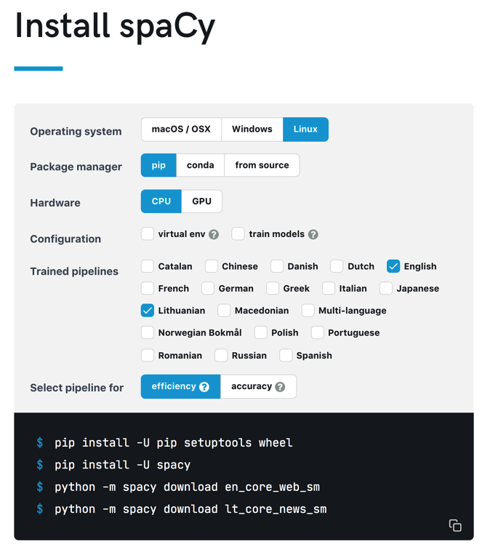
https://spacy.io/usage

Slide 14
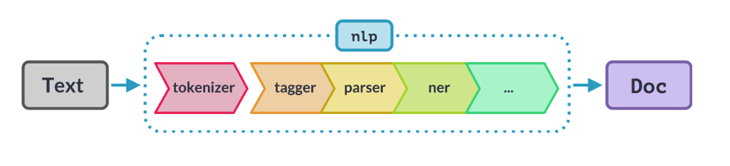
NLP Pipeline
tokenizer : segment text into tokens
tagger: assign Part-of-Speech tags
parser: identify dependencies, and assign Dependency labels
ner: identify and tag predefined Named Entities
other user defined processes can be included in the pipeline

Slide 15
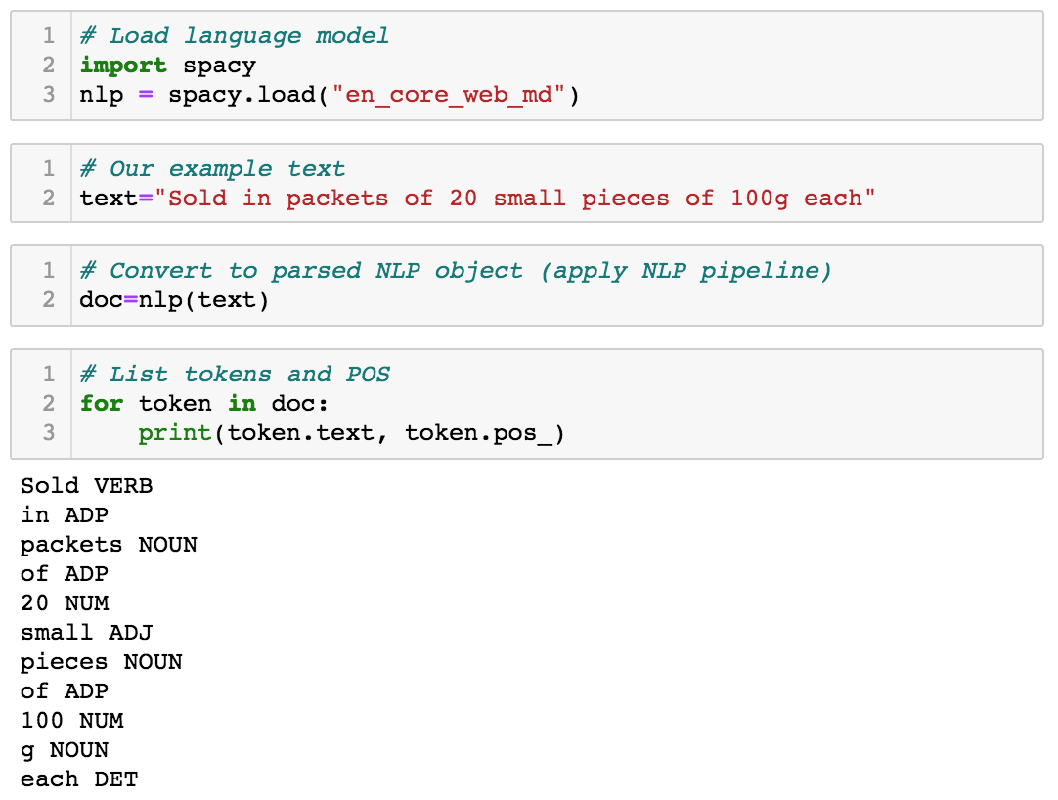
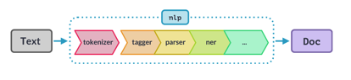
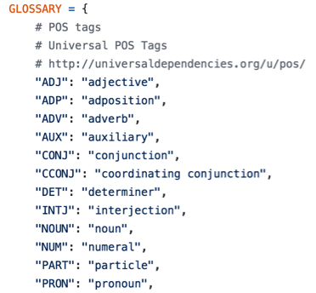

Slide 16
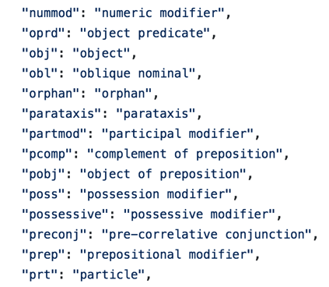
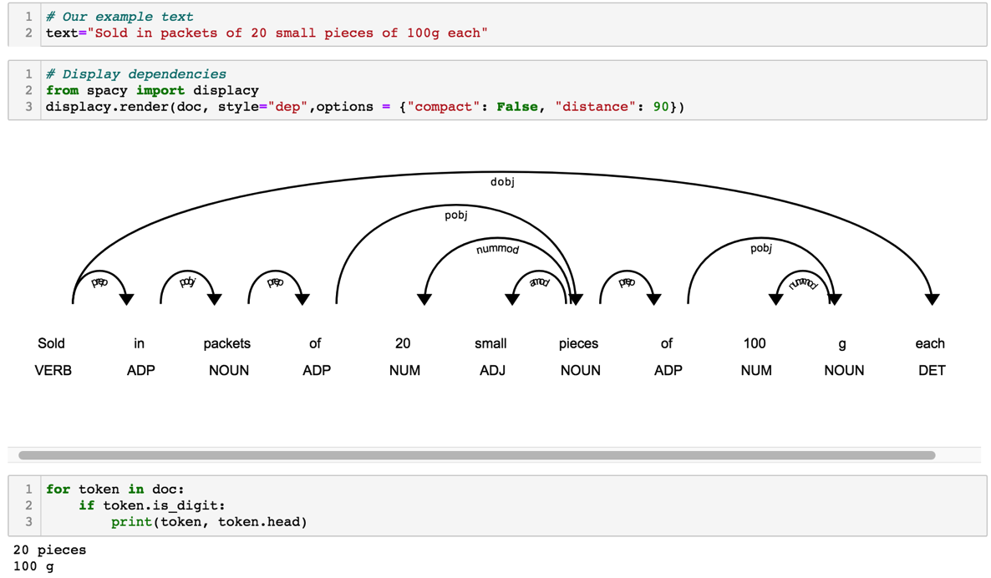

Slide 17

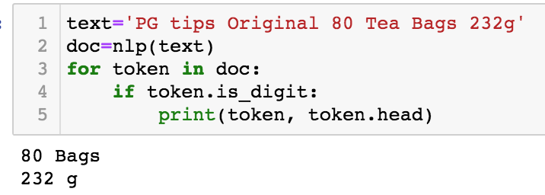

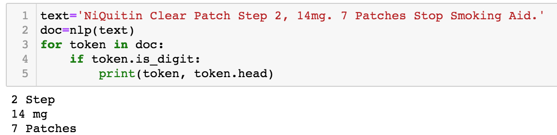

Slide 18

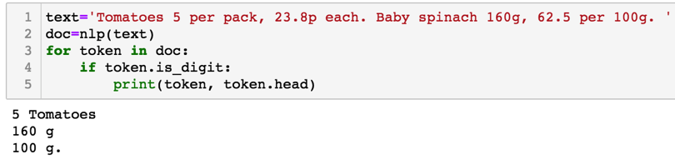
Not very meaningful

Slide 19

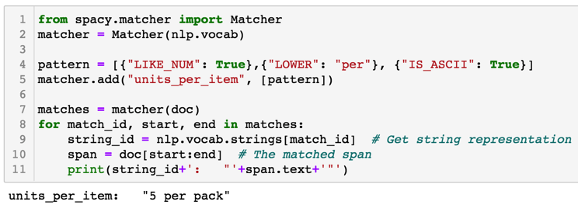
Rule-based Pattern Matcher
Like regular expressions but using Tokens instead of characters.

Slide 20
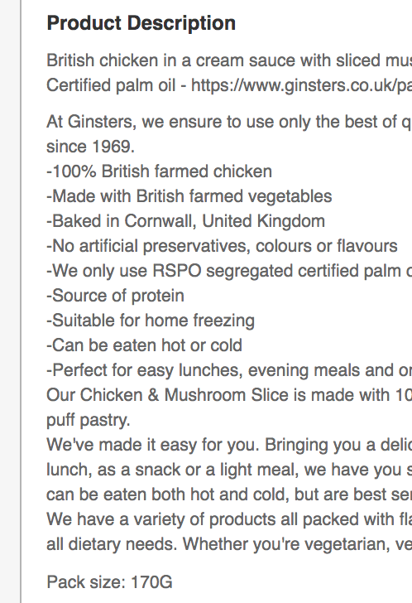
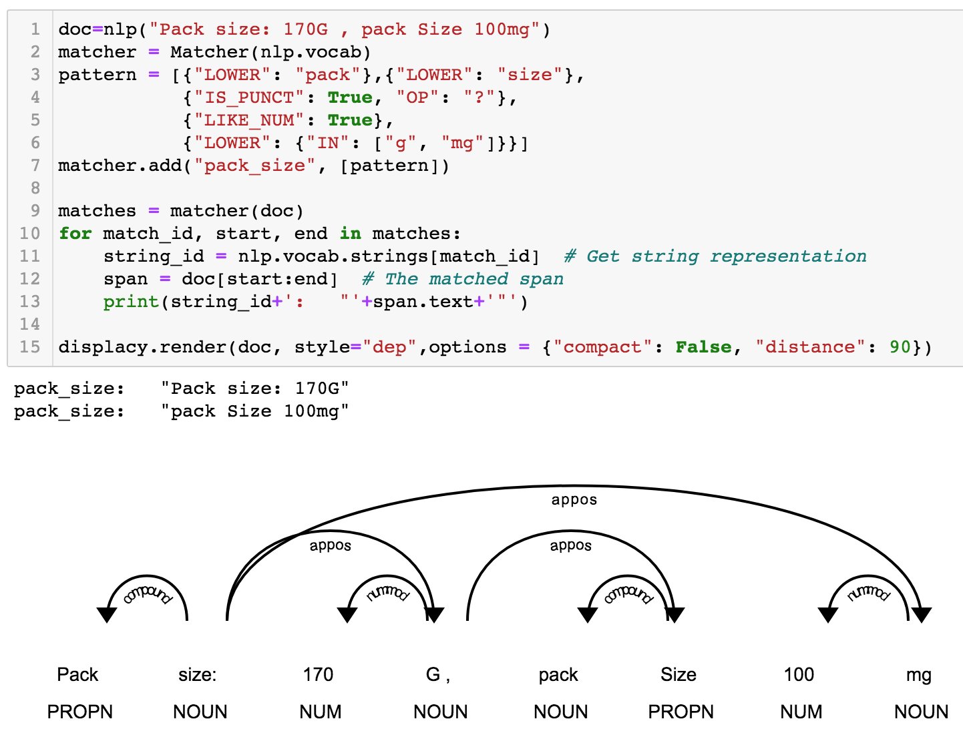
Rule-based Pattern Matcher

Slide 21
Who did what ?
Sentence 1: John founded a startup
Sentence 2: John, a friend of mine, founded two AI startups.

Slide 22
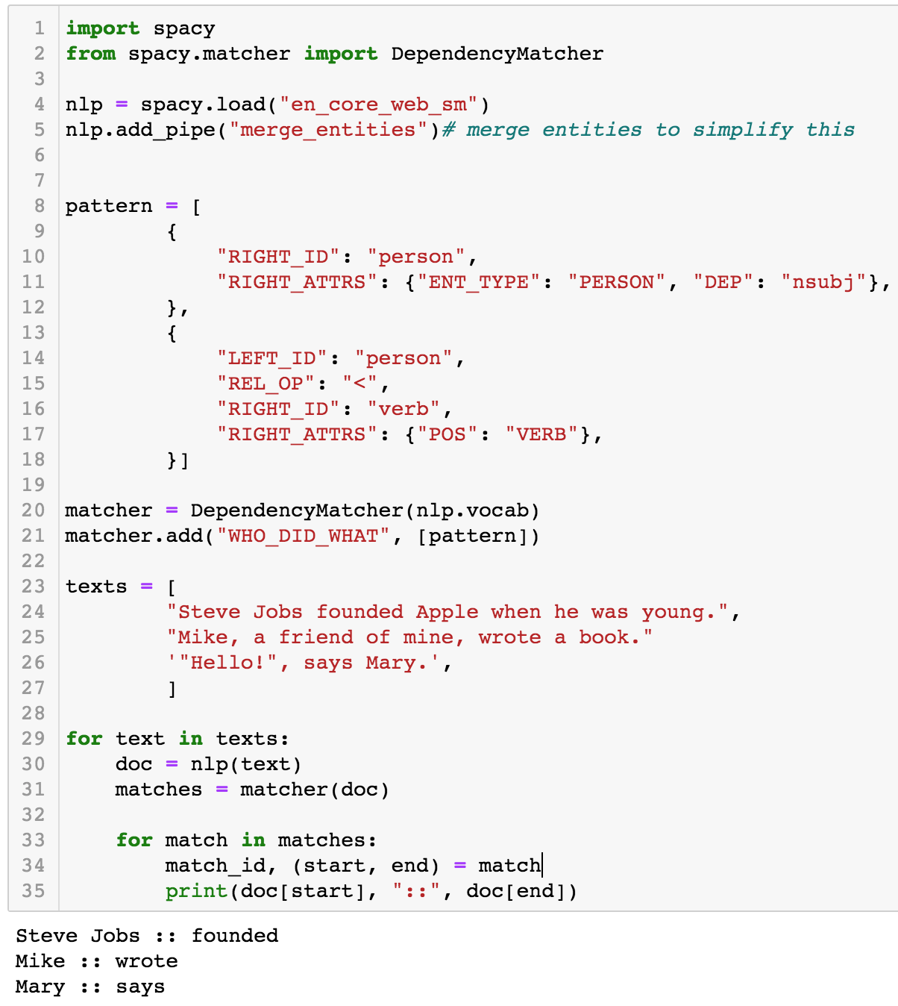
Dependency Matcher
Who did what ?
Notes:
http://markneumann.xyz/blog/dependency_matcher/

Slide 23
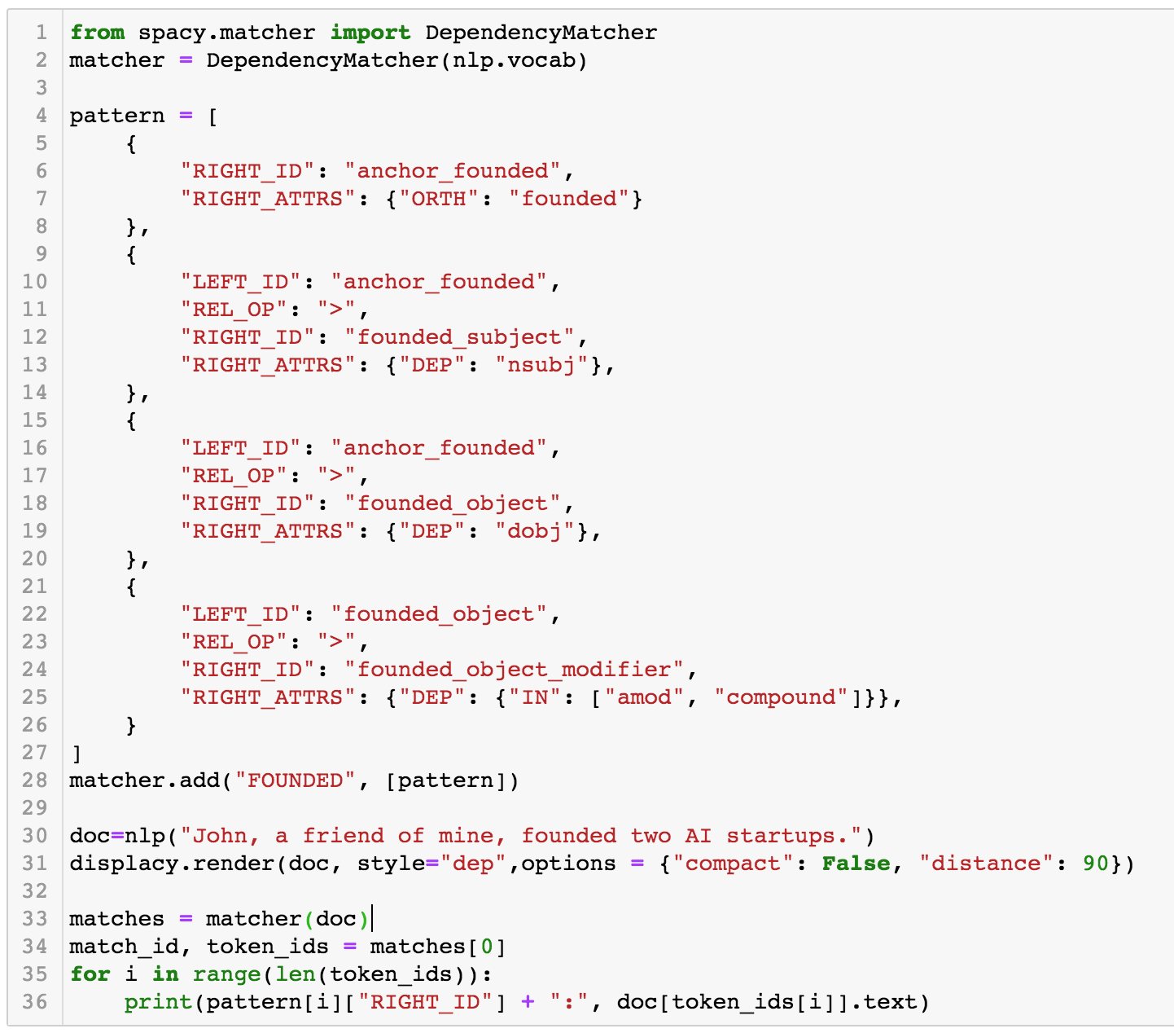
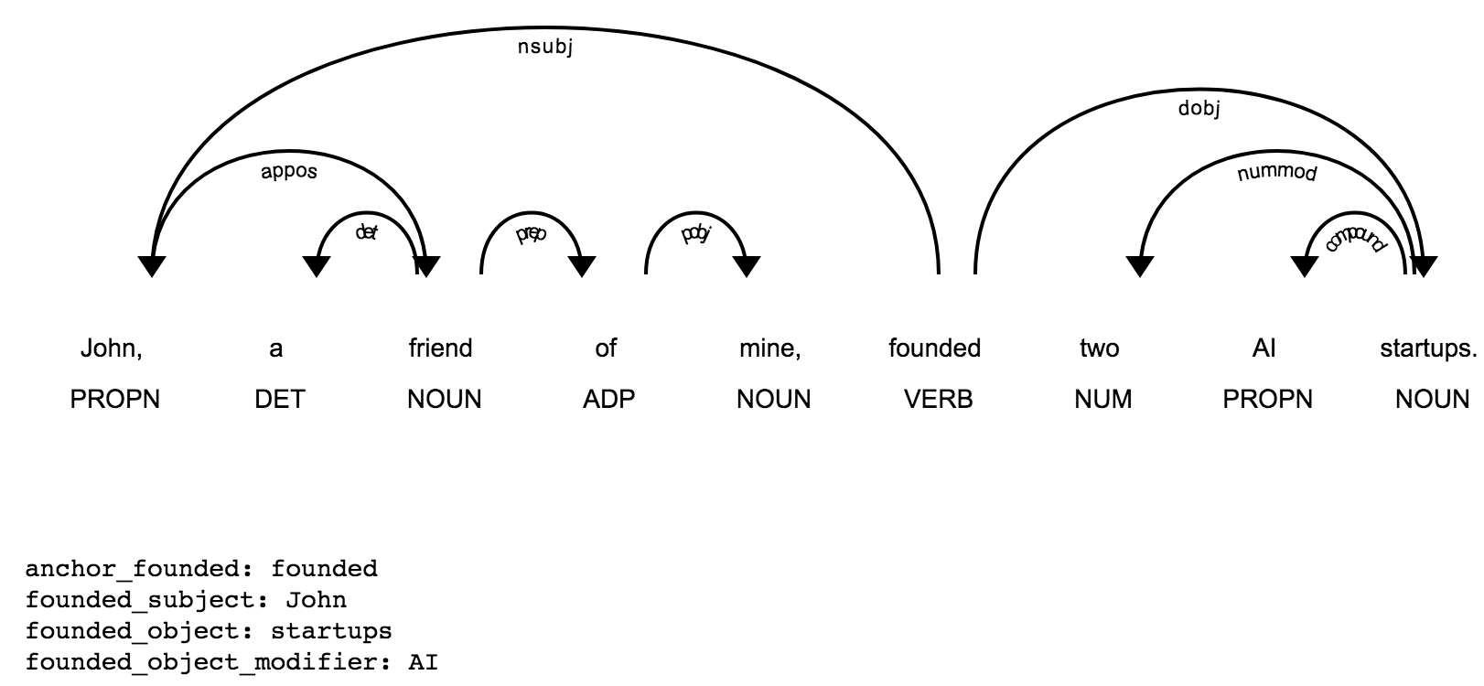
Dependency Matcher

Slide 24
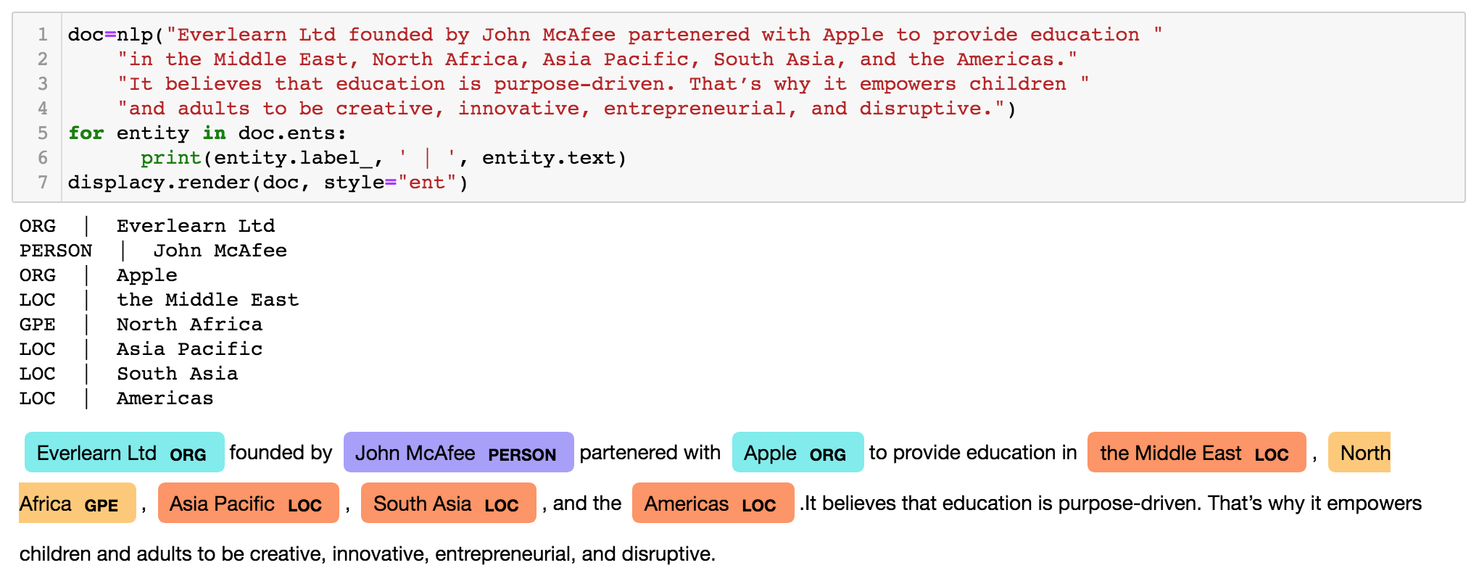

NER – Named Entity Recognition
Information retrieval task to locate, segment, and categories a pre-defined set of entities.

Slide 25

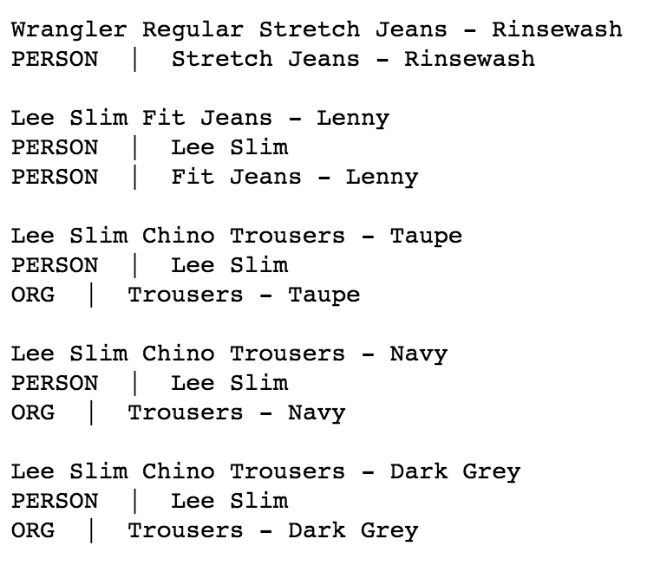
NER – Named Entity Recognition

Slide 26

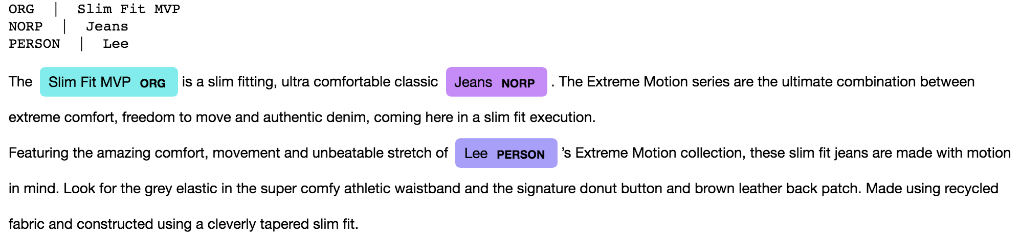
NER – Named Entity Recognition

Slide 27
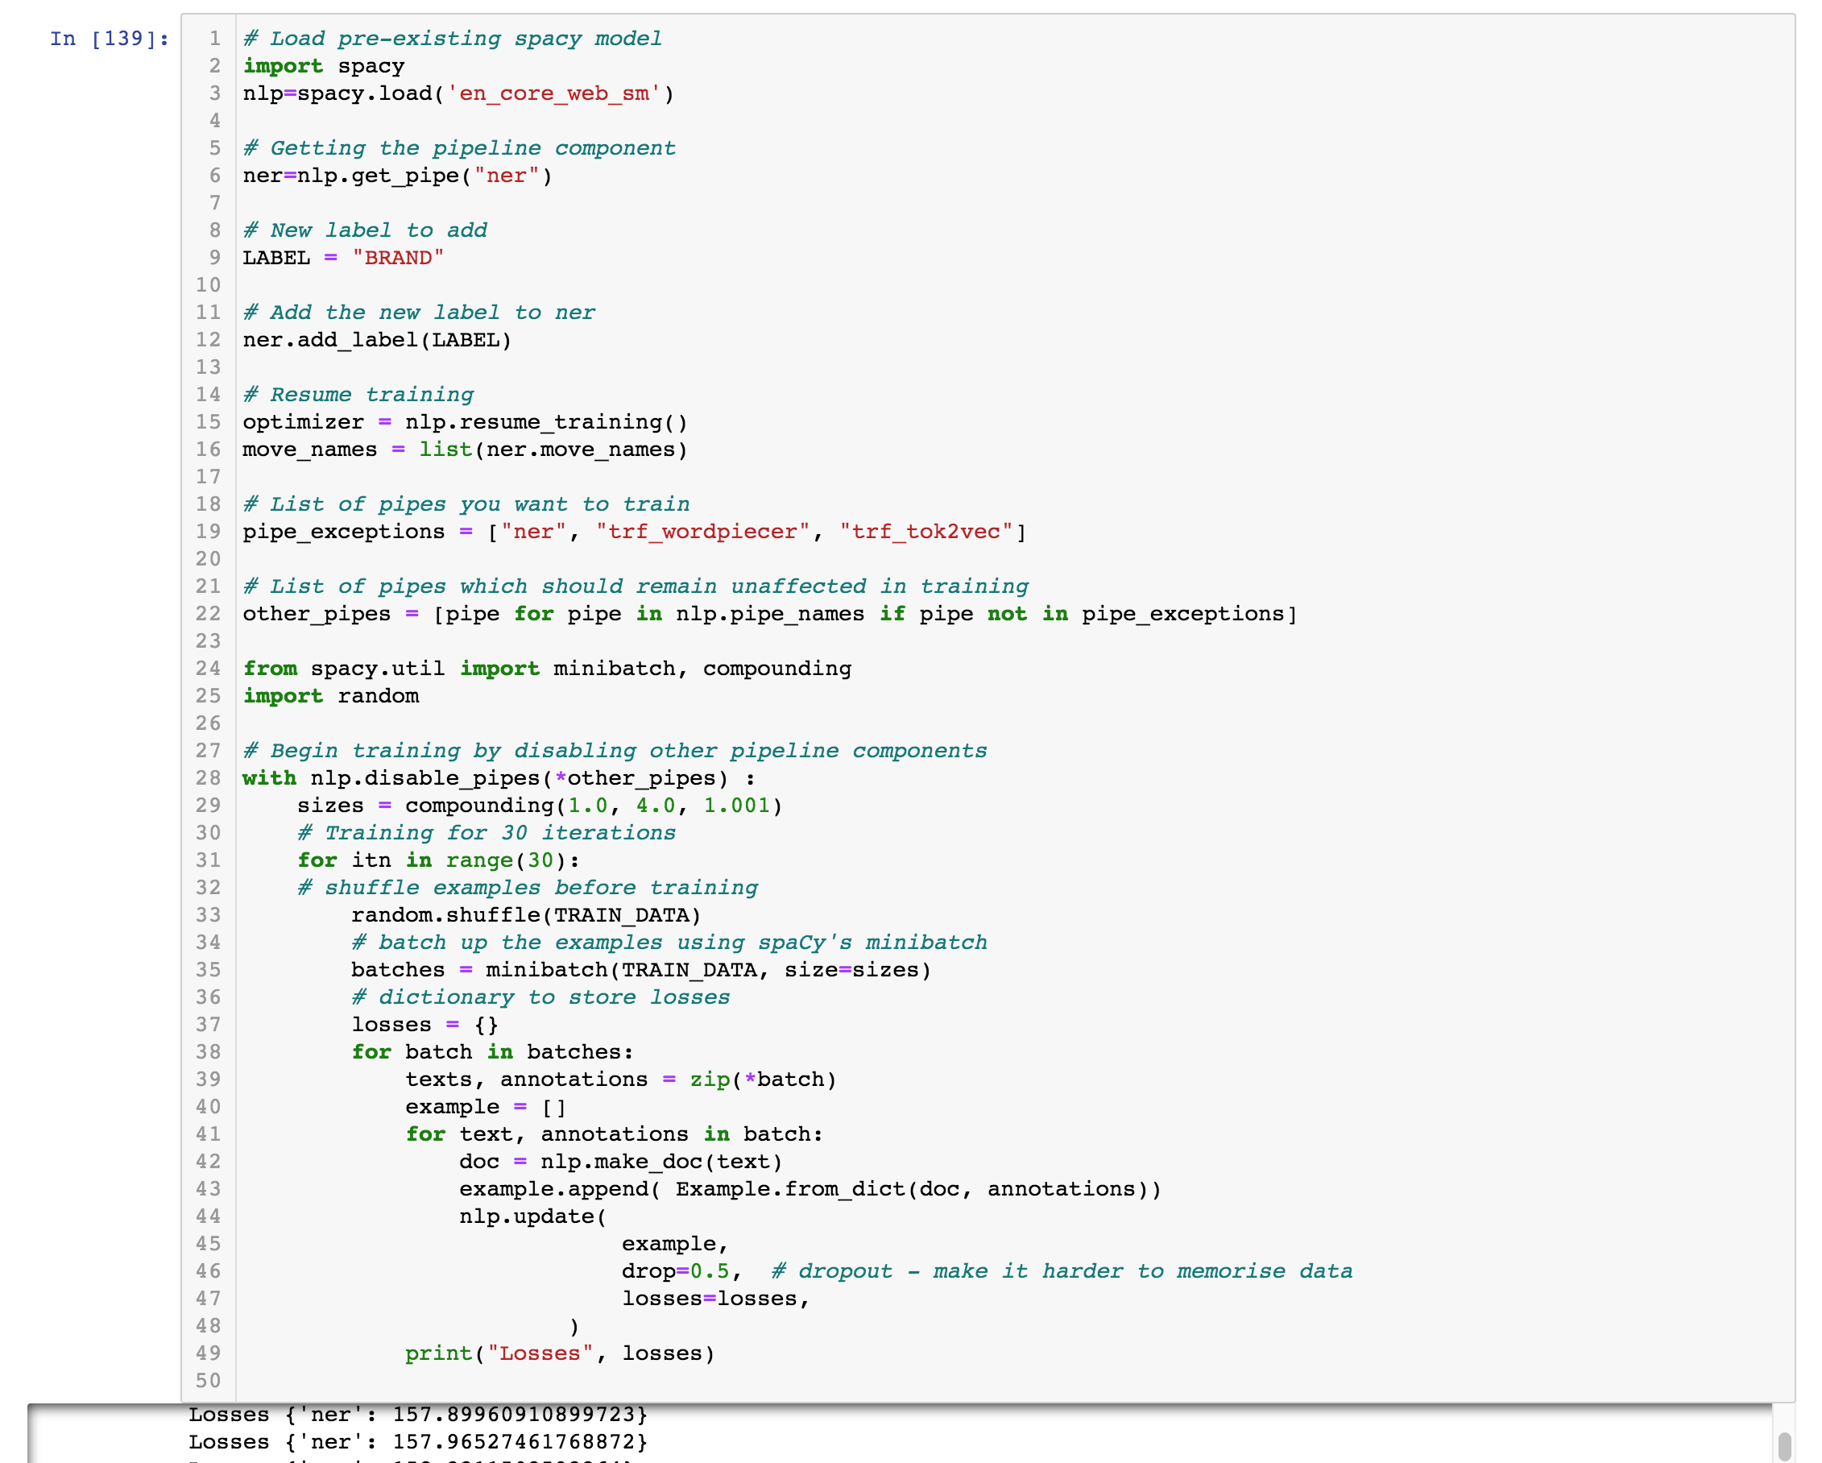
NER – custom model
Notes:
https://www.machinelearningplus.com/nlp/training-custom-ner-model-in-spacy/

Slide 28
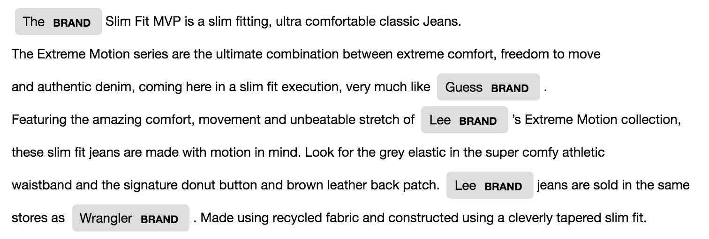
NER – Named Entity Recognition

Slide 29
Recap
SpaCy and the NLP Pipeline
Dependency elements
Rule-based Pattern Matcher
Dependency Matcher
Named Entity Recognition
Supporting files: https://github.com/thornad/oxycon21

Slide 30
Other NLP functions
Word vectors and transformers: spaCy
Summarization: Gensim
Sentiment analysis: Pattern
Translation: DeepL (API)

Slide 31



